Slide 1
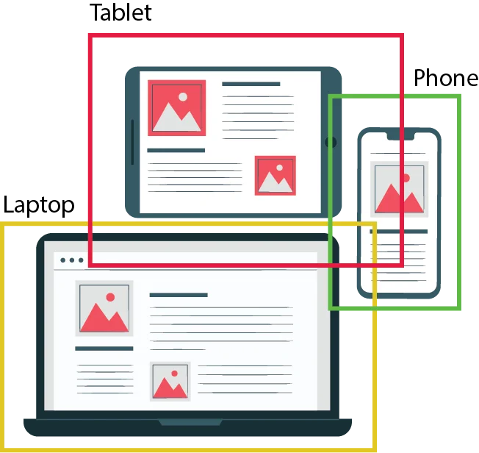
YOLO
Network
Object Detection
in real time
Name: Akhmedov Yusufjon Muhammad ugli Major: Computer Engineering
Student Number: 202438404

Slide 2
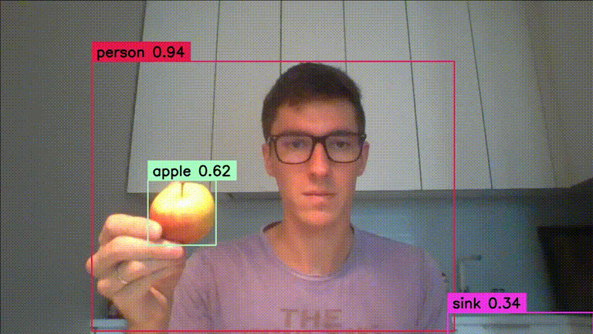
WHAT IS OBJECT DETECTION ACTUALLY?
Object detection is a computer vision technique for identifying and localizing objects within an image or a video.

Slide 3

WHAT IS YOLO Network
WHY IS YOLO popular
HOW DOES YOLO work
QUESTION MARK

Slide 4


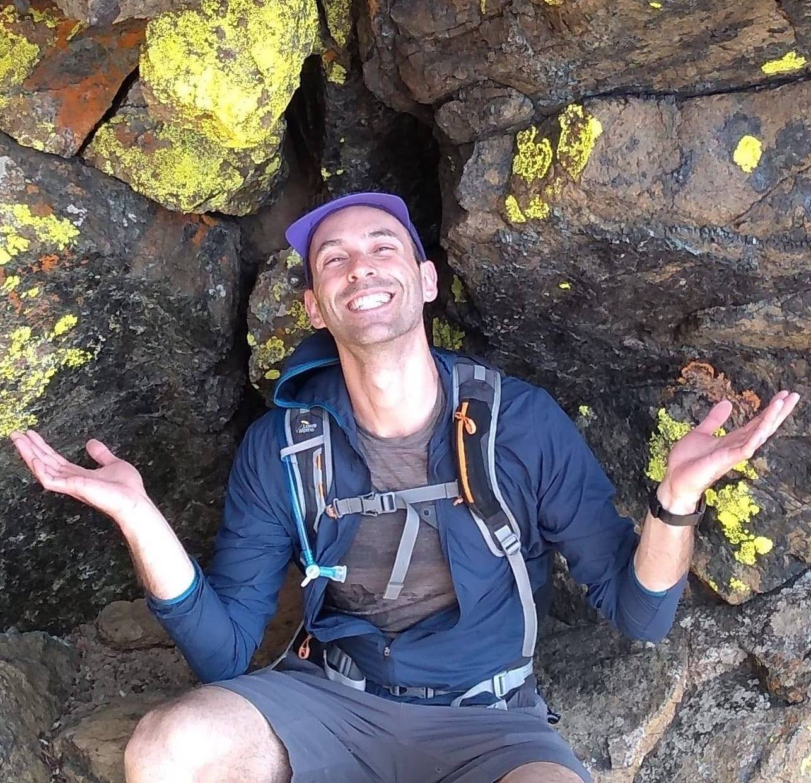

YOLO – (You Only Look Once) real-time object detection algorithm
2015 – Start of history by Joseph Redmon, Santosh Divalla, Ross Girshick, Ali Farhadi – YOLO v1

Slide 5




Popular?
Extremely fast – the mean Average Precision (mAP) is 45 FPS ~ 91 FPS
Also compared to other detectors (SSD, R-CNN, etc.)
High detection accuracy
with few background errors
Open source – publicly available for everyone
Forking - Many improvements in a limited time
GitHub Forks

Slide 6
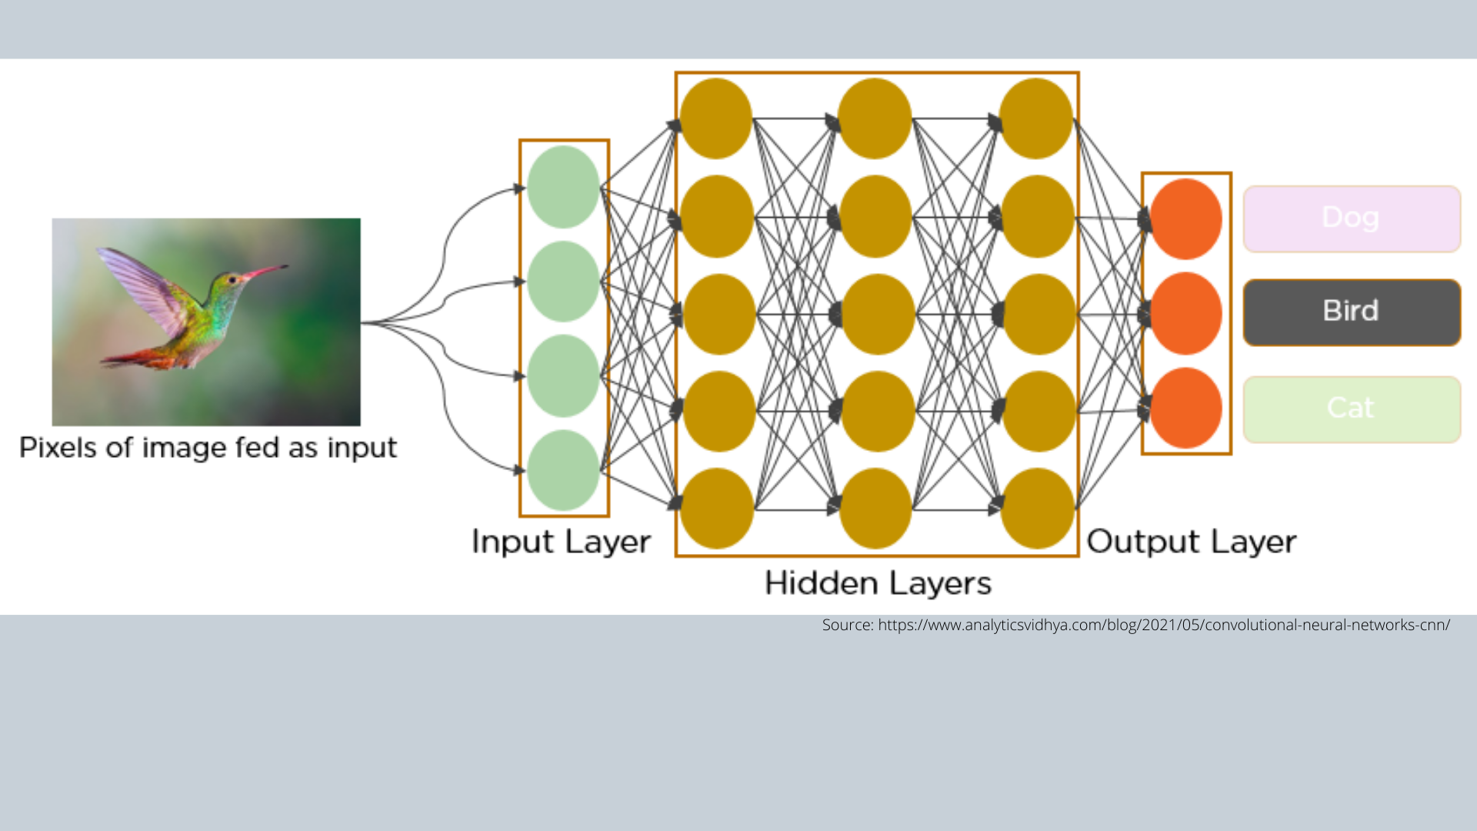
A DL model - identifies and locates multiple objects in an image using
a single forward pass through a convolutional neural network (CNN).
Example of simple CNN network processing of image of bird!

Slide 7
YOLOv1 was a groundbreaking start — simple but limited.
It uses a single CNN to divide the image into a 7×7 grid and predicts bounding boxes and classes in one pass.
It’s fast but struggles with small or overlapping objects and has limited accuracy.

Slide 8
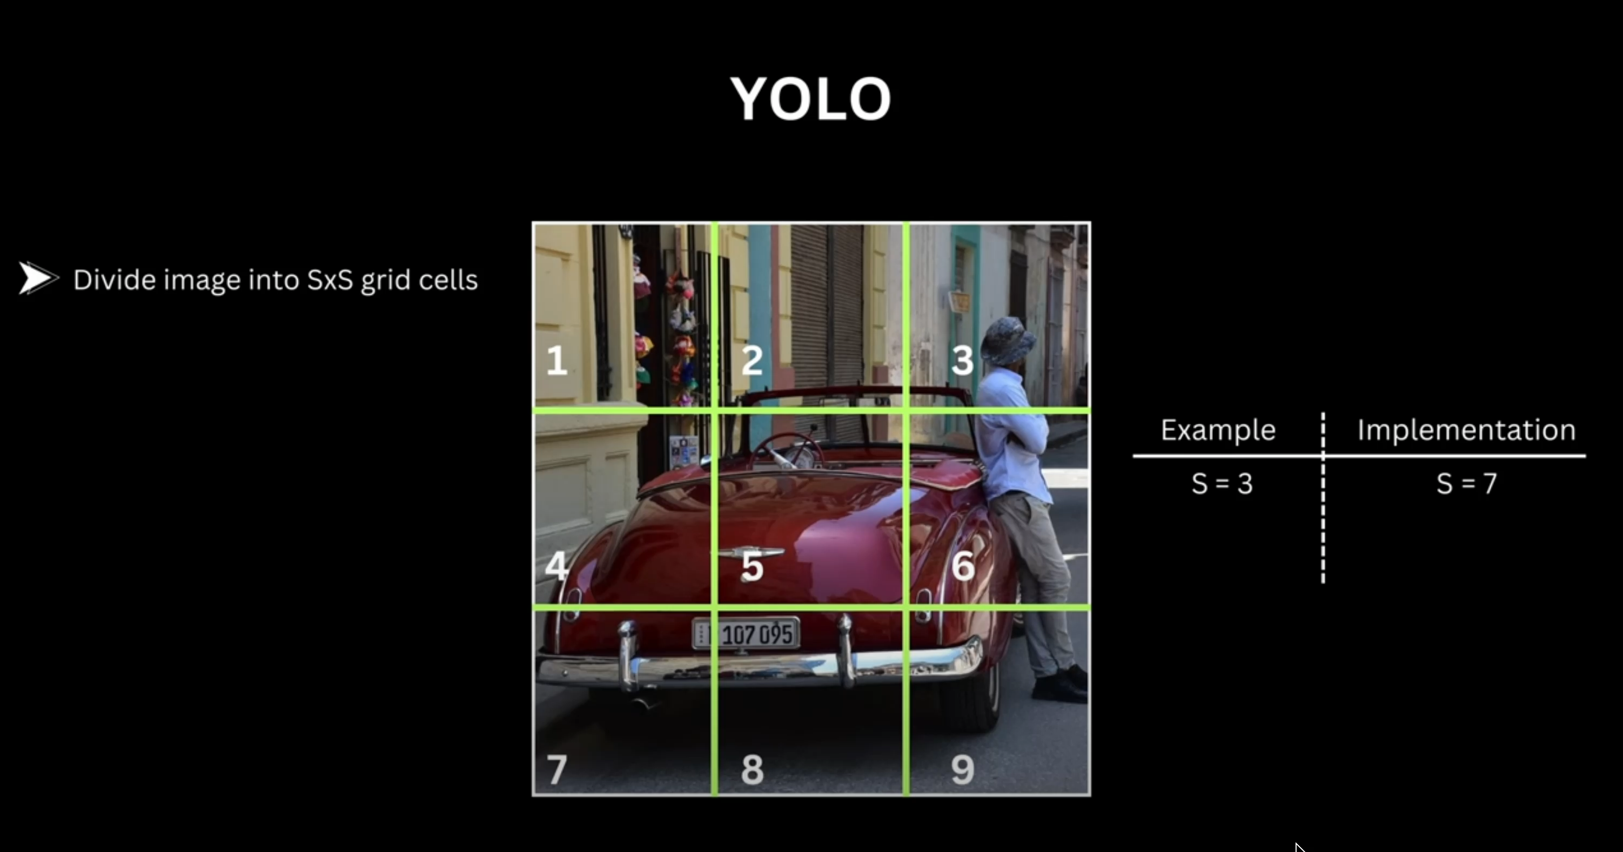

Slide 9
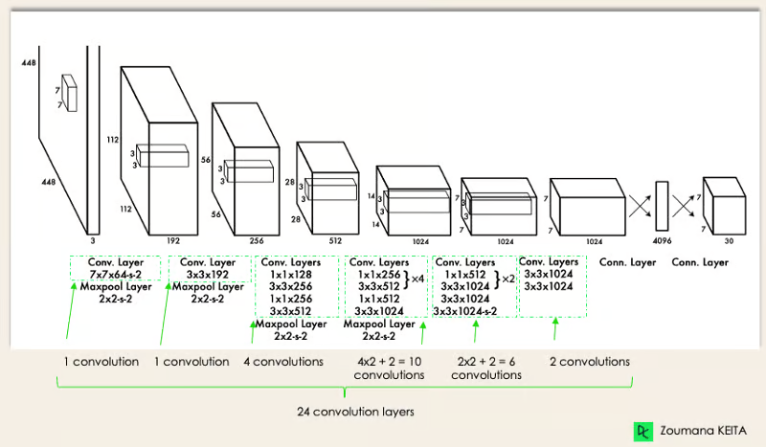
YOLO V1 Architecture - 2015
https://paperswithcode.com/method/yolov1

Slide 10
YOLOv8 (your "YOLOv11") is a powerful, modern, and production-ready system capable of high-precision detection across tasks and devices.
YOLOv8 is a modern, high-performance object detection model built by Ultralytics.
It uses advanced CNN architecture with multi-scale detection and anchor-free methods for better accuracy.
YOLOv8 supports detection, segmentation, and classification, and is optimized for real-time use on various devices.

Slide 11
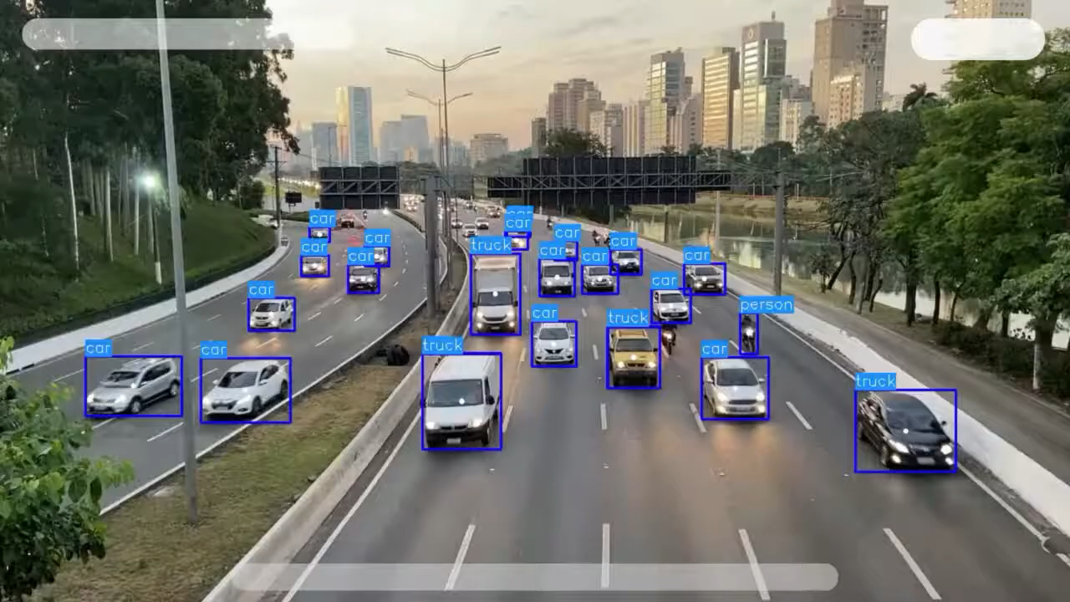

Slide 12
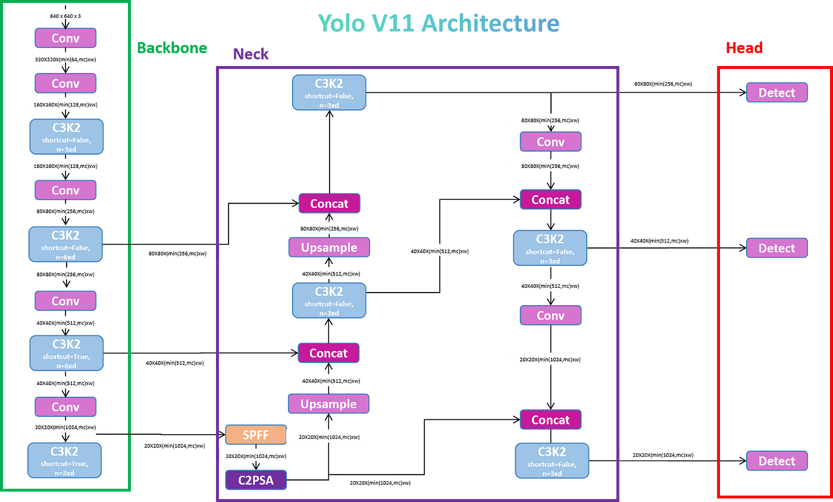
Yolov8 -> Ultraliytcs 2024 -> “Yolo 11”
https://www.ultralytics.com/blog/ultralytics-yolo11-has-arrived-redefine-whats-possible-in-ai

Slide 13
YOLO Applications Real life examples

Slide 14
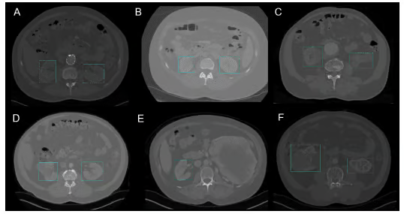
Healthcare - Kidney Detection in CT using YOLO v3e

Slide 15
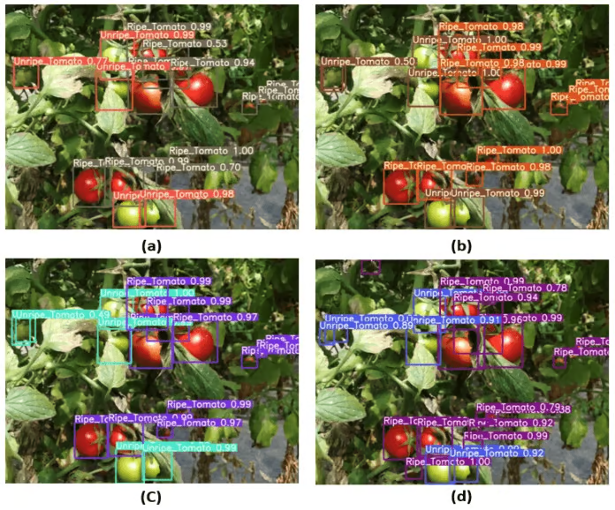
Agriculture - Harvesting robots are vision-based robots that were introduced to replace manual picking of fruits

Slide 16
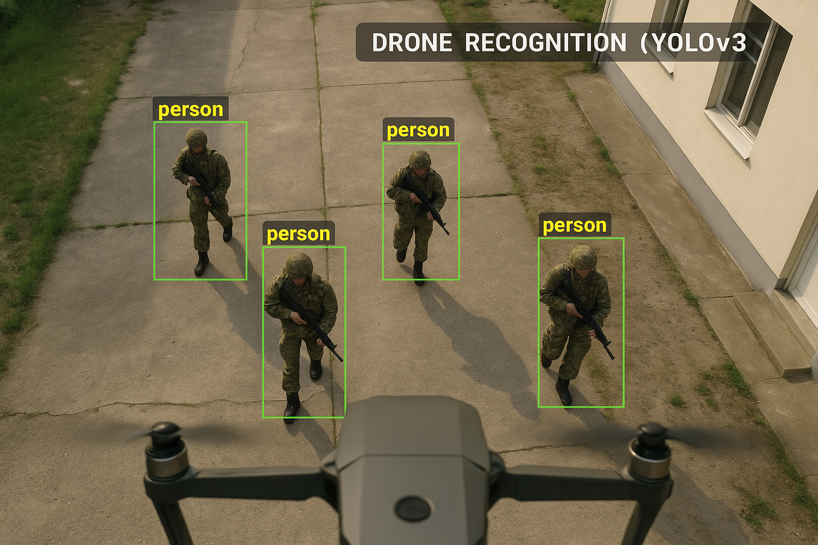
Military - YOLO is used in drones to detect and track people, vehicles, weapons, and infrastructure in real time.

